Slide 1
Discrete-time state transition models in R
Kyu Lee, Ph.D.
HEOR 533
Jan 24, 2024

Slide 2
Class objectives
1. Review Markov cohort models
2. Learn how to implement a Markov cohort model in R
Basics in R
Briggs A et al model in R
Preview the assignment

Slide 3


Markov cohort model (review)
Markov models in medical decision science simulate health transition over time (discrete- vs. continuous- time)
Markov models are used to estimate long-term cost and health outcomes beyond the empirical study period, often attached to the end of a branch in decision trees
e.g. For a cohort of patients who received treatment A and experienced post-treatment complication (with a probability of 0.2), what are their 5-year health and cost outcomes?
Building blocks of Markov models include health states, transition probabilities, cycle, rewards or pay-offs
-
Notes:
cycle: transition happens over a period of time
cost and health outcomes associated with each health state

Slide 4

What is R?
R is a free programming language and environment for statistical computing and graphics
Users can add additional functionality such as mechanistic simulation modeling by using built-in functions, user-defined functions, and packages
Any users can contribute to creating open-sourced R packages
Notes:
R packages need to undergo the R CMD CHECK process

Slide 5
R studio
R studio is an IDE (Integrated Development Environment) for R where users can edit the code, import data, visualize graphics more easily compared to when writing the codes directly to R console.

Slide 6
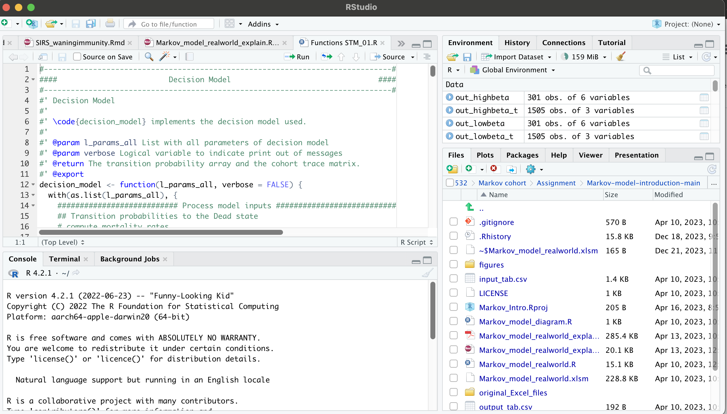
R studio
Notes:
additional functionality

Slide 7
R studio
Notes:
additional functionality

Slide 8
R studio
Notes:
additional functionality

Slide 9
R studio
Notes:
additional functionality

Slide 10
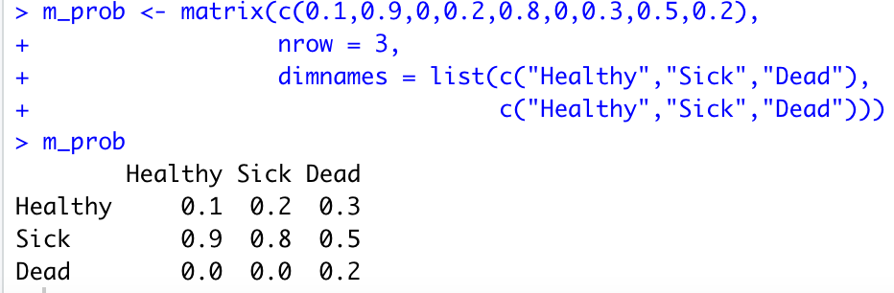
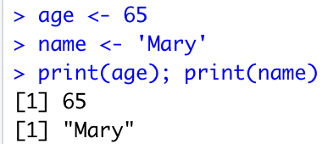
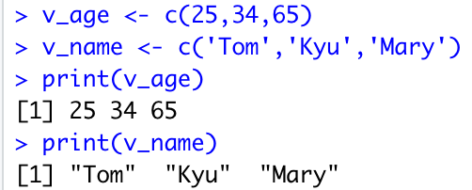
Basics in R
Creating variables of scalar, vector, and matrix: an operator ‘<-’ assigns a value to a variable
Matrix
Scalar
Vector
Notes:
c : combine
byrow = FALSE by default

Slide 11
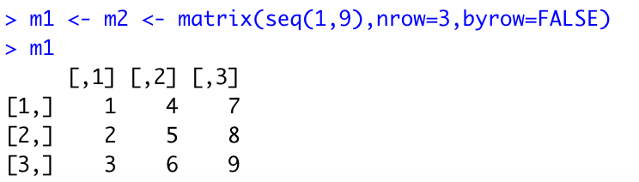
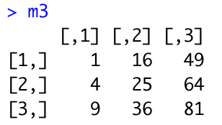
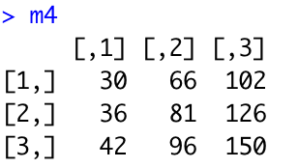
Basics in R
‘*’ operator implements element-wise multiplication between two matrices
‘%*%’ operator implements matrix multiplication between two matrices (dot product of each row vector (m1) and column vector (m2)
=
X

Slide 12
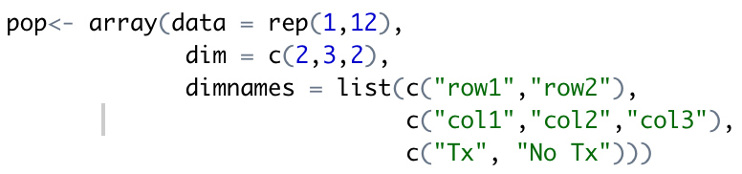
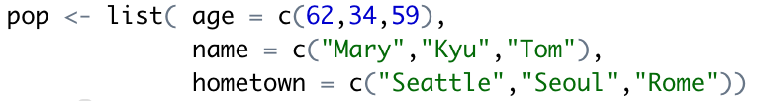
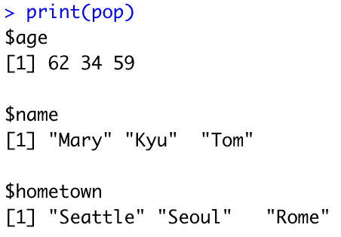
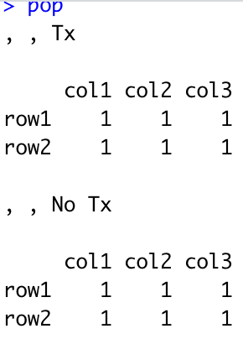
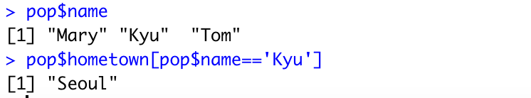
Basics in R
Array: a general data structure defined by a fixed number of dimensions; vectors (1D) and matrices (2D) are an example of array
List: a generic object consisting of an ordered collection of objects; can accommodate multiple data types
Notes:
Array can only accommodate one data type
(will be coerced to a list if you try to have multiple data types in array)

Slide 13
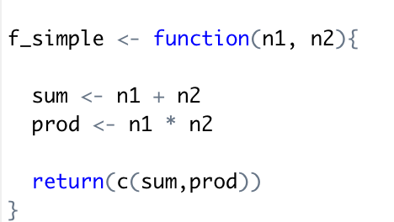
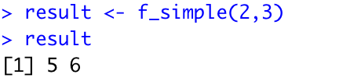
Basics in R
A user-defined function
Name of the function
Arguments needed for the function
Operations
Return outputs
Notes:
general structure of user-defined function
If there are no explicit returns from a function, the value of the last evaluated expression is returned automatically in R.

Slide 14
Translating an excel model in R
Category | Excel | R
Model organization | Define input parameters, run models, and compute outcomes in separate tabs | One code can streamline the works from defining input parameters, running models, to computing outcomes
Input parameters | Enter a value in a cell Link a cell to other cells | Assign a value to a variable Specify equations
Running Markov model | Repetitive calculation over rows | For-loop
Sensitivity analysis | Macro | For-loop

Slide 15
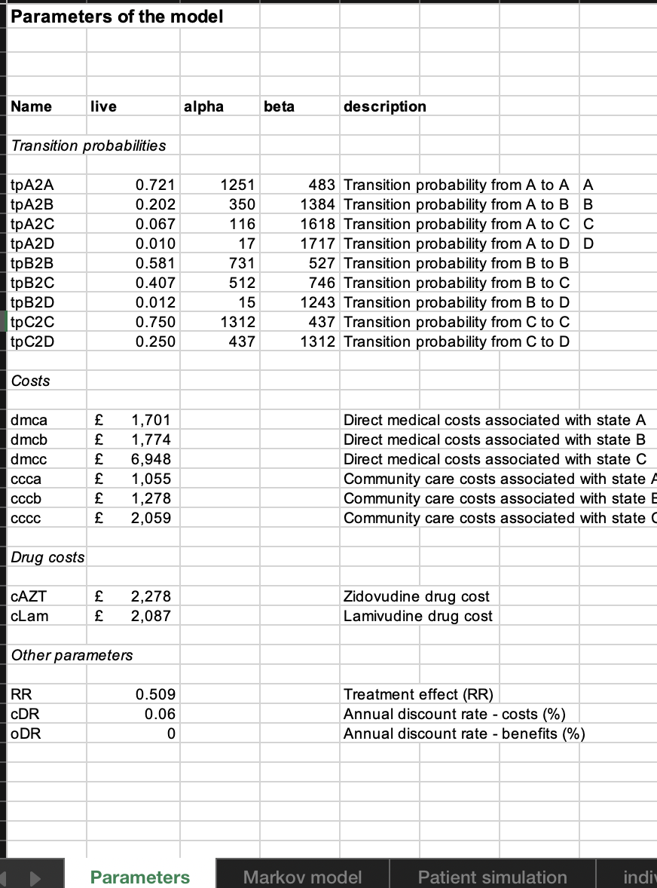
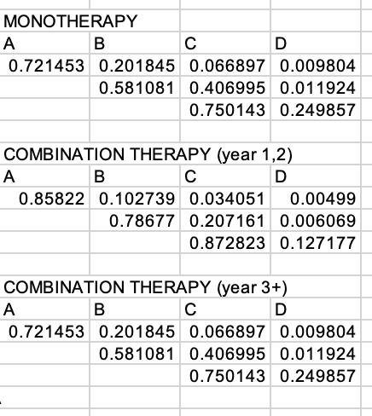
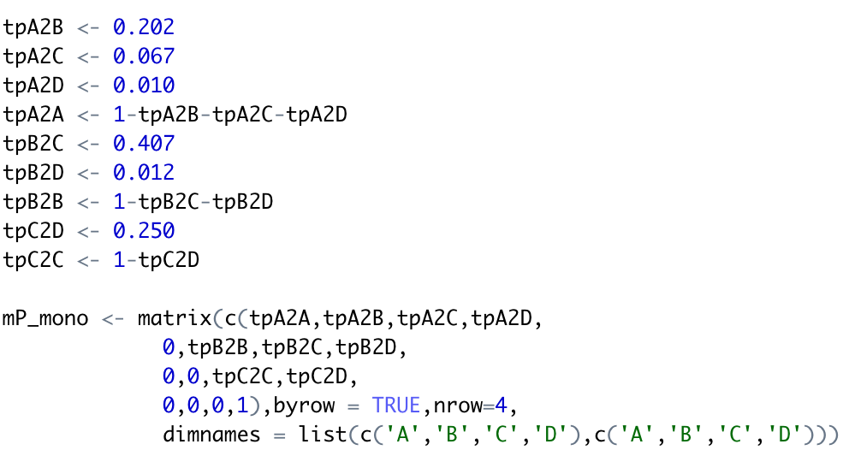
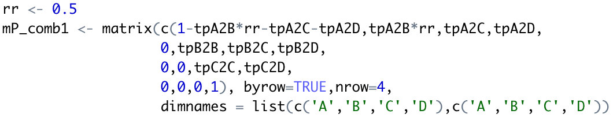
Translating an excel model in R
Each cell in the transition probability matrix refers to a parameter value or a value calculated based on multiple parameter values
In R, parameters and transition probability matrix can be defined as a variable of scalar or matrix
The code makes the calculation more explicit, reducing the risk of transcription errors
Briggs excel model example

Slide 16
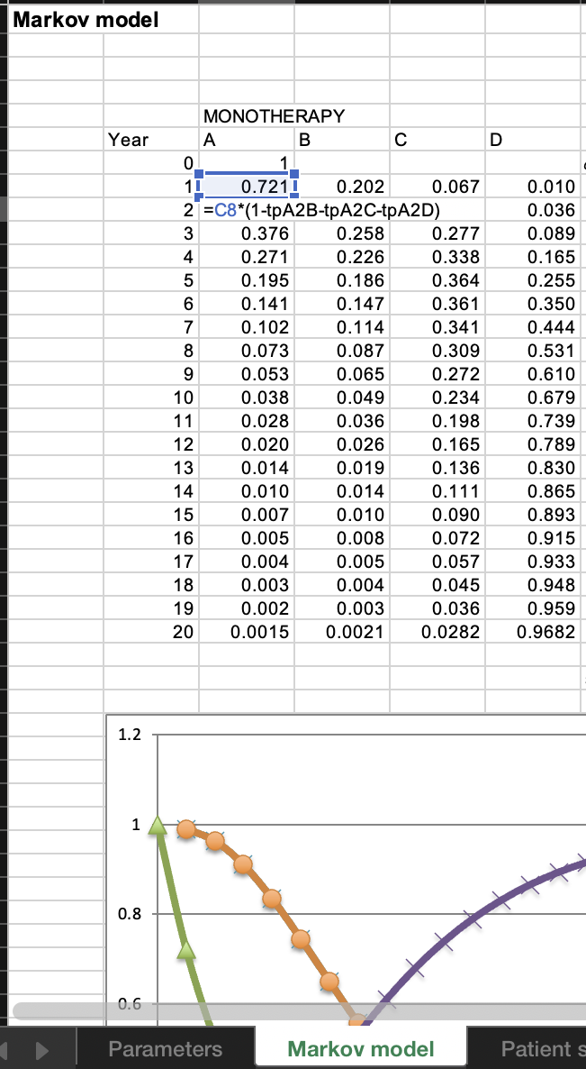
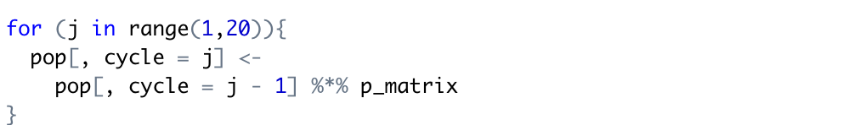


Translating an excel model in R
Pop distribution at t=1
 | A | B | C | D
A | 0.75 | 0.2 | 0.06 | 0.01
B | 0 | 0.59 | 0.4 | 0.01
C | 0 | 0 | 0.7 | 0.3
D | 0 | 0 | 0 | 1
 | A | B | C | D
 | A | B | C | D
 | 1 | 0 | 0 | 0
$$=$$
$$×$$
Pop distribution at t=0
Transition probability matrix
Repeat until t = 20
<- matrix multiplication
Repeat until t = 20
Notes:
Markov model – health trasitions over cycle

Slide 17
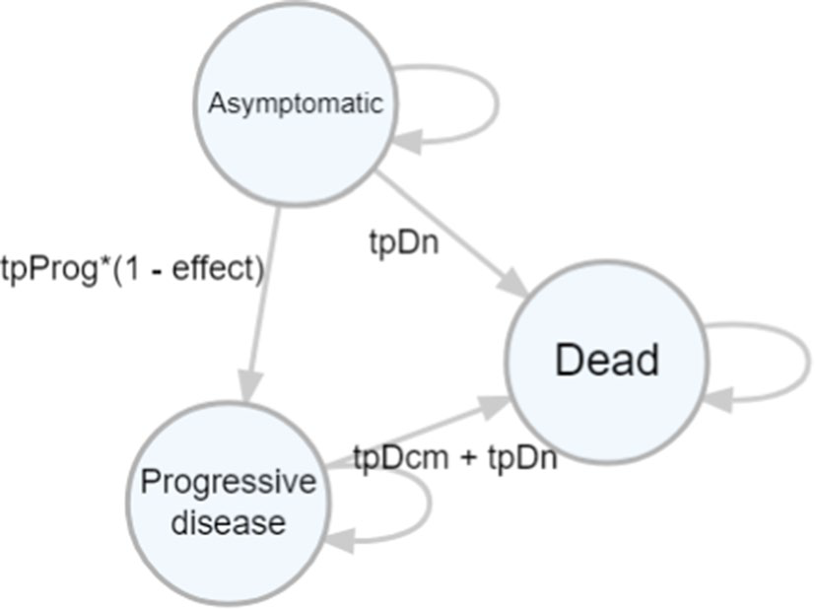
Review of Briggs A. et al. Model
3-state Markov cohort model
The risk of progressing from Asymptomatic to Progressive Disease decreases by 50% with treatment
Disease progression accelerates with age
Progressive disease has excess mortality (tpDcm)
There is cost for excess mortality among progressive diseases (i.e. transitional cost from progressive to dead)
Notes:
additional functionality

Slide 18

Questions?
Q&A

Slide 19
R session – Review and run the code
Open the R code (Markov_model_realworld_explain2_2024.Rmd)

Slide 20
R session – class exercise (optional)
Make the following changes and discuss how ICER of treatment changes
Reduce the treatment efficacy from 0.5 to 0.2
Increase the starting age from 55 to 65

Slide 21
Assignments
A new end-of-life care was approved based on the clinical trial result that it can reduce the excess mortality due to progressive disease by 50%. It costs $500.
Decision makers (e.g. clinicians) requested information on whether they should provide this end-of-life care in addition to the original treatment to reduce the disease progression.
Using the same health state transition model, conduct a cost-effectiveness analysis considering three strategies: 1) without treatment 2) with treatment but no end-of-life care, 3) with both treatment and end-of-life care
Provide a table of cost and QALY of three strategies and report ICER. It is optional to generate ICER graph.

Slide 22
Wrapping up
1. Review Markov cohort models
Discrete-time health transition models simulate health transitions over time and estimate long-term health and cost outcomes
2. Learn how to implement a Markov cohort model in R
R is a free programming language and has flexible functionality to build simulation models such as health transition models
Compared to excel models, Rmodels can streamline the process of building the model in an explicit way in a single code file with lower risk of transcription error.

